Slide 1

RISK AND RESILIENCE BOOTCAMP
2

Slide 2


Slide 3
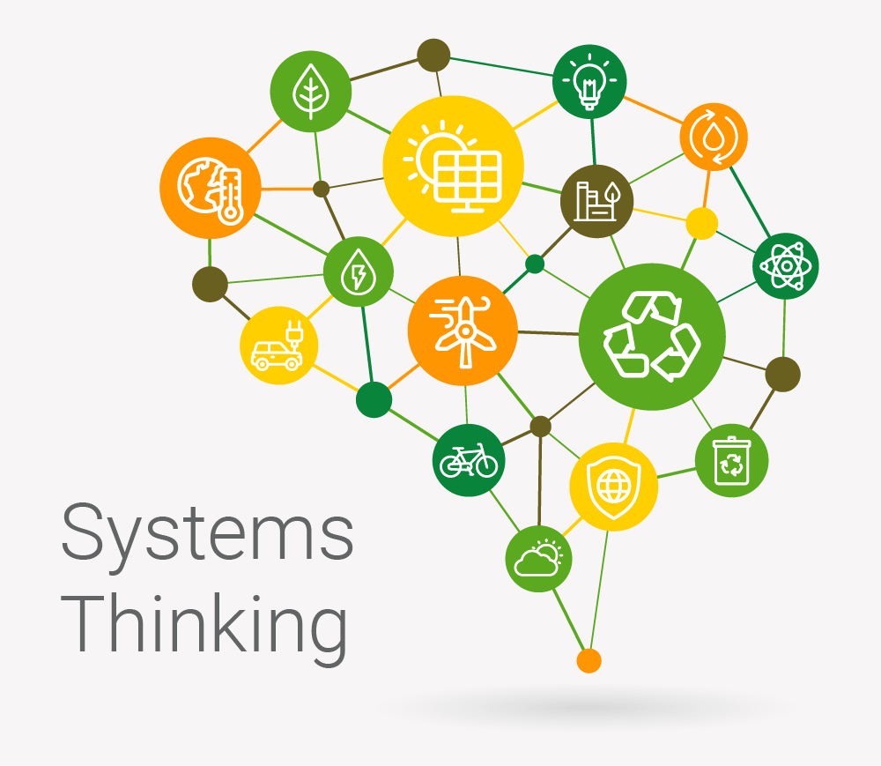
Systems thinking
This module introduces some of the basic ideas of systems thinking
Defining systems thinking
How it applies to risk analysis
Cascading failures
Managing complexity

Slide 4
Systems Thinking
Systems thinking is a way of seeing and talking about reality
It emphasizes wholes, interrelationships and patterns of change rather than just isolated parts
It is a mindset that focuses on how everything is connected
Coupled with a set of tools/techniques that help make sense of complexity
For example: causal loop diagrams, behaviour-over-time graphs, stock & flow models
Doesn’t just look at one system or one process in isolation
Asks instead
How do the people, the process, and the systems interact?
What feedback loops, dependencies, delays or unintended effects arise when these interplay?

Slide 5
Systems Thinking
Why systems thinking matters
IT systems, business processes, and human actors are deeply intertwined
A change in one often shifts behaviour in others, sometimes in unexpected ways
Without systems thinking
There is the risk of designing controls or modifying processes in a silo, missing side-effects in other processes and missing hidden dependencies that might cause cascading failures
Systems thinking helps identify emergent behaviours
Specifically that the whole is greater than the sum of parts
For example, when a process runs across multiple teams and systems, the risk is not just each part failing, it's how their interactions can produce cascading or amplifying effects

Slide 6
Systems Thinking
Using systems allows an analyst to
Map feedback loops, both positive and negative
Recognize delays and time lags between action and effect
See non-linearities where a small change can triggers much larger changes
Understand dependencies among people, process and systems
Move the analysis of causes
From “What happened in system X?”
To “Why did the interaction across systems/processes/people cause the failure?”

Slide 7
Systems Triad
people-process-systems triad
People
Roles, communication, culture, decision-making, skill levels, hand-offs
Process
Flow of tasks, decision points, hand-offs, controls, workflows, exceptions
Systems (IT / technical)
Software, hardware, interfaces, data flows, automation, integrations
Systems thinking
Emphasizes how these three overlap and interact.
Example:
A process may call for a manual hand-off (people), but if the system interface is slow (systems), it may cause delay (process) which leads to human workaround, raising risk (people) of human error

Slide 8
Applying Systems Thinking
Define the boundary of your system
Identify what “system” you are analyzing
For example: “vendor on-boarding process + IT systems + stakeholders”
Clarify what’s inside, what’s outside, and how it interacts with the environment.
Map the elements and their relationships
Use diagrams (causal loop diagrams, stock/flow diagrams, behaviour-over-time) to visualise how people, processes and systems interact
Identify feedback loops and delays:
For example
“System slows → manual work increases → backlog grows → errors increase → system redesign becomes urgent”

Slide 9
Applying Systems Thinking
Look for unintended consequences
When you change one part what are impacts elsewhere
For example:
If we automate a manual approval, what happens elsewhere?
Are there other processes that are affected downstream? Does this impact regulatory compliance in other processes?
Analyze the dynamic behaviour over time
Risk is not always at a single moment
Delays, accumulation of backlog, system degradation, human fatigue are all time-based phenomena
Use systems thinking to inform mitigation
Once you see the interplay, you can design interventions that take into account people, process and systems together (not just patch one)

Slide 10
Systems Thinking Tools
Causal loop diagram
Visualizes cause-and-effect chains and feedback loops
Useful to show how a process flaw or system delay may loop back and increase risk
Behaviour over time graph
Chart of how a key variable changes over time
For example: backlog size, error rate, system performance

Slide 11
Systems Thinking Tools
Stock and flow diagram
Shows accumulation (stock) and rates (flows) in processes
For example: tasks waiting in queues for processing
Rich pictures
Qualitative depiction of system relationships, useful early in workshops to surface how people perceive the system
Systems archetypes
Generic patterns like “Shifting the Burden”, “Fixes that Fail”, “Drifting Goals”
These help recognize recurring risk patterns in people-process-system interaction
Sort of like design patterns for identifying problematic systems architectures

Slide 12
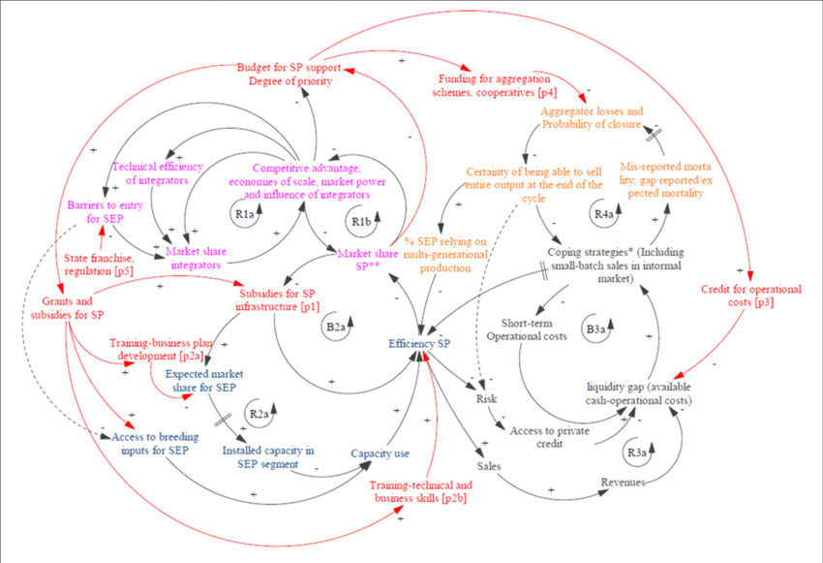
Causal loop diagram

Slide 13
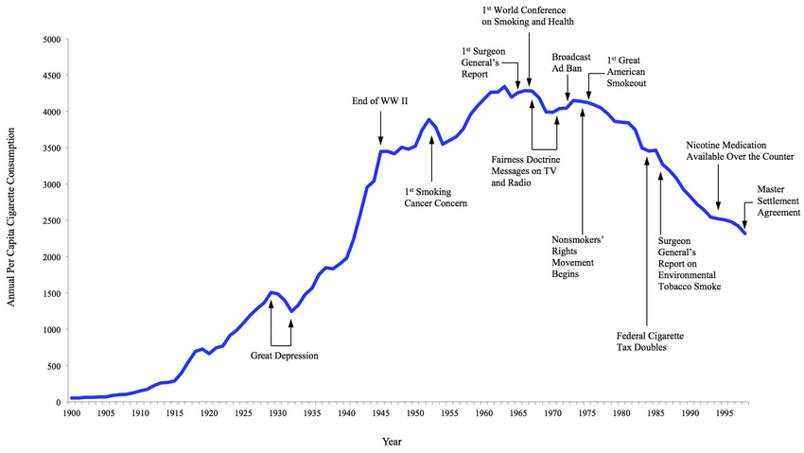
Behaviour Over Time Graph

Slide 14
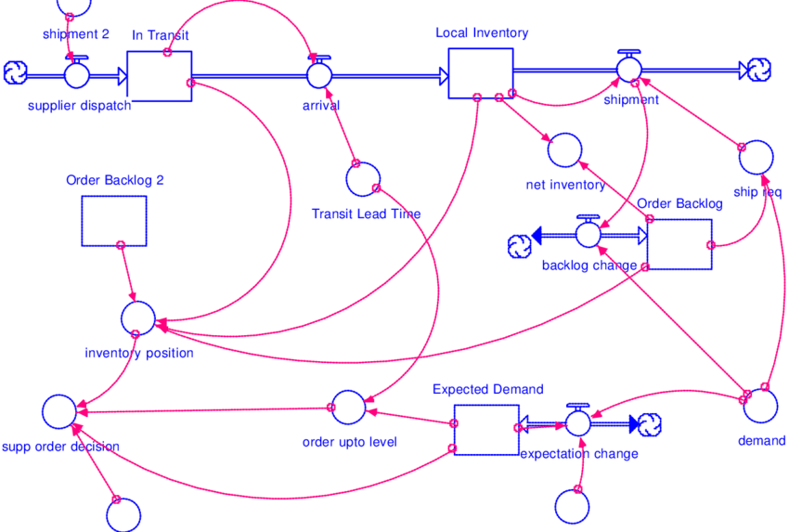
Stock and flow diagram

Slide 15
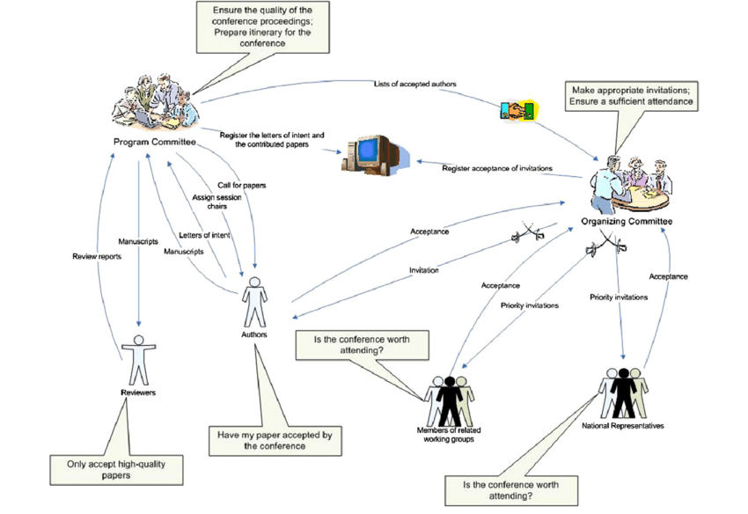
Rich picture

Slide 16
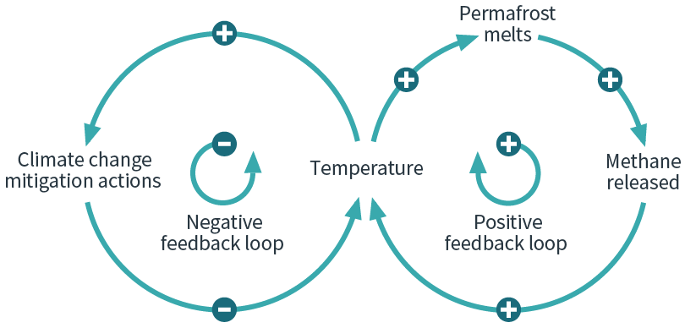
Feedback loops

Slide 17
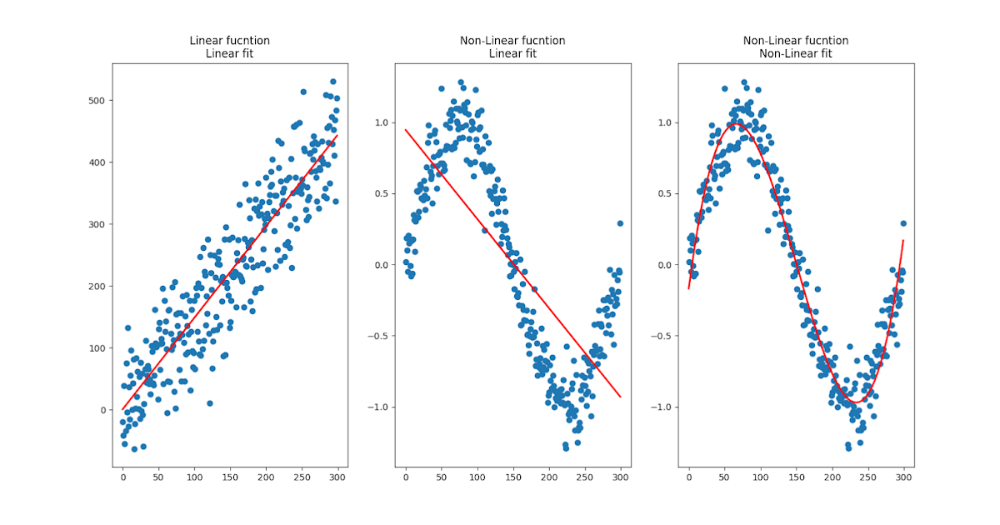
Linear vs non-linear

Slide 18
Tipping points
A tipping point
The critical threshold at which a small change in one part of a system causes a sudden and often irreversible shift in the system’s overall state or behaviour
In complex systems
Feedback loops, inter-dependencies, and accumulated pressures can make a system appear stable right up until it reaches a tipping point
Beyond that threshold, the system rapidly reorganizes itself into a new pattern, often with disruptive consequences
Often seen in ecosystems, economies, and IT infrastructures
Basically a tipping point is where “more of the same” suddenly becomes “no longer the same”

Slide 19
Tipping points - Key Characteristics
Non-linearity
Cause and effect are not proportional
Incremental stress builds quietly, but the response suddenly accelerates once the threshold is crossed
Feedback-driven change
Reinforcing feedback loops amplify disturbances once they start
For example, error impacts workload performance that produces more error resulting in a loss of control
Irreversibility or hysteresis
Returning conditions to their pre-tipping-point state doesn’t always restore the system
New equilibria may form
For example: being locked into a crash recovery loop

Slide 20
Tipping points - Key Characteristics
Sensitivity to small triggers
Minor perturbations like a delayed patch, missed communication can tip a system already under hidden stress into collapse
Early-warning signals
Systems nearing tipping points often show growing volatility, slower recovery from small disturbances, or accumulating backlogs
Each warning signal on its own may not be enough to trigger a control
But when these signals together may be symptomatic of an emerging system instability

Slide 21
Tipping points - Examples
Infrastructure overload
A system’s performance declines gradually as load increases
But beyond a tipping point, latency spikes, processes hang, and cascading service outages occur
Operational fatigue
Staff under constant high workload start making small mistakes
Error rates build until quality collapses
A human-process tipping point.
Security risk escalation
Patch delays accumulate
Dependency vulnerabilities multiply
One exploit triggers a chain reaction that brings systems offline
Cultural or governance shifts
Persistent blame culture leads to suppressed reporting until a major incident forces a governance overhaul

Slide 22
Tipping points - Relevance to Risk
Monitoring leading indicators is as important as tracking lagging events
Traditional analysis assumes proportional change
Systems thinking reveals that risk often behaves non-linearly
Understanding tipping behaviour helps detect when an environment is approaching instability before catastrophic change occurs
Early detection allows for preventive resilience
Adjusting load, redistributing responsibilities, or introducing dampening feedbacks before the threshold is crossed

Slide 23
Mitigation and Detection Strategies
Identify critical thresholds
Use metrics (e.g., latency, backlog size, error rates, turnover) to define points where performance sharply degrades
Monitor leading indicators
Look for signals such as increasing variability, repeated near-misses, or slower recovery from small disruptions
Build buffers and redundancy
Introduce spare capacity or modular design so that stress is absorbed gradually rather than accumulating.
Strengthen feedback controls
Implement mechanisms that balance reinforcing loops
For example: automatic throttling, escalation alerts, adaptive load balancing.
Encourage transparent reporting
A culture that surfaces weak signals early prevents invisible accumulation of risk pressure

Slide 24
Mitigation and Detection Strategies
Tipping points
Are the dynamic consequence of feedback loops, delays, and interdependencies
When mapping causal loops, a tipping point is often where a reinforcing feedback loop overwhelms balancing controls
By identifying and modelling these loops, risk teams can anticipate thresholds and design interventions that restore balance before irreversible change occurs
The formal study of tipping points is in the mathematical domain called chaos theory
Studies that some systems shift into to configurations at tipping points
The configurations are called attractors
An IT system can go from stable to a number of unstable states
The effort required to revert back to a stable state can be very high

Slide 25
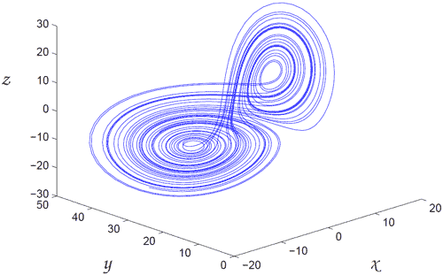
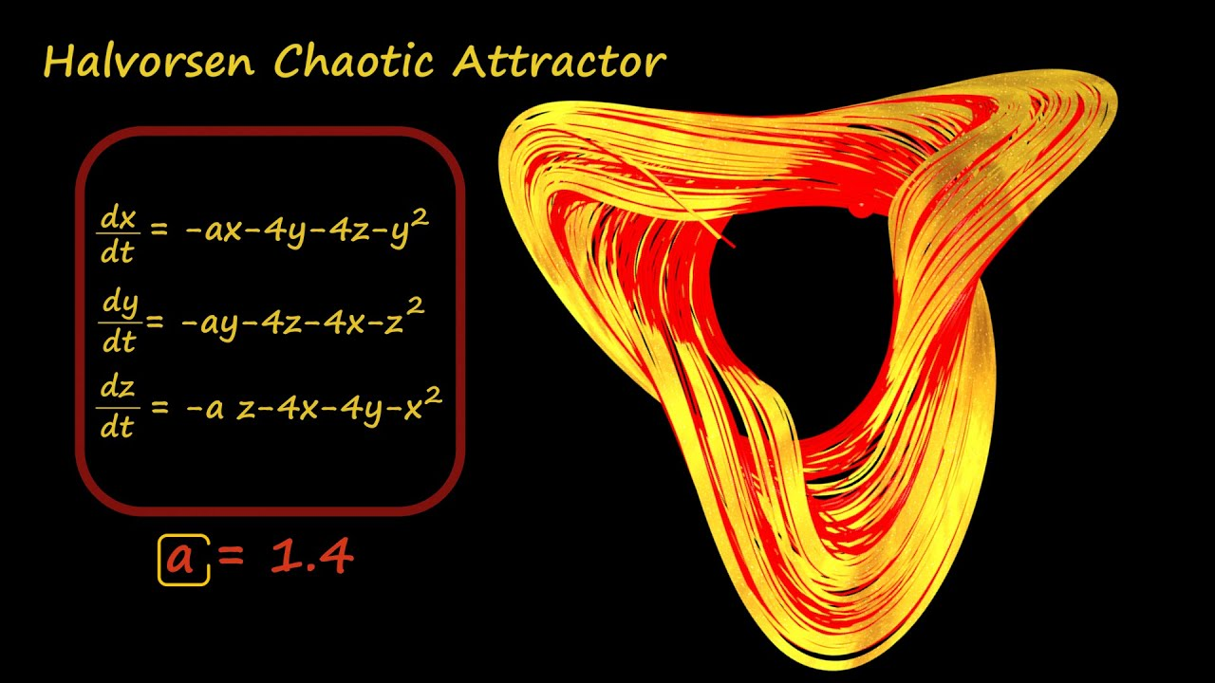
attractors

Slide 26
Cascading Failures
A cascading failure
Occurs when a failure or disruption in one component of a system triggers failures in other components
Often in sequence or via feedback loops, resulting in a large-scale systemic disruption.
A small error or delay in one process or team can propagate through downstream processes, across systems, or between teams
Effects are amplified by hidden dependencies or lack of redundancy
Example:
A key system goes offline
Manual workaround puts load onto a team
That team delays
Downstream system receives incorrect input
Compliance control is bypassed
Regulatory breach occurs.

Slide 27
Hidden Dependencies
Dependencies are often not visible in standard process maps
For example, Team A’s output becomes system input for Team B, but the dependency is informal/un-documented
Hidden dependencies increase risk because
They create single points of failure (if Team A fails, Team B can't proceed)
They produce tight coupling (the downstream team or system has no buffer)
They reduce visibility and monitoring (failure upstream may not be flagged until it impacts downstream)
Systems thinking identifies these by asking
Which processes/systems/teams are reliant on another?
What would happen if that upstream function failed or was degraded?

Slide 28
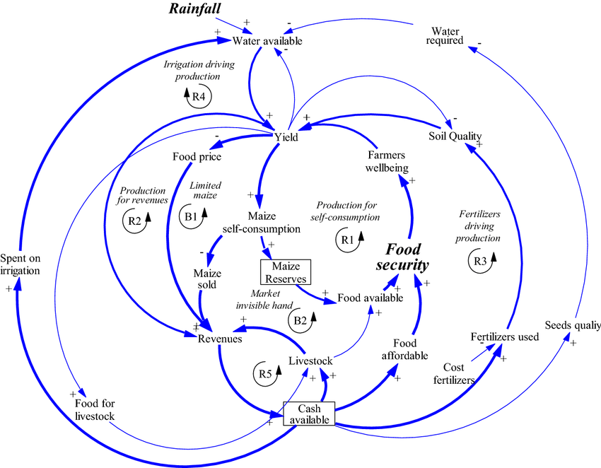
Causal loop diagram

Slide 29
Causal loop diagram
Purpose and overview
It helps visualize how different variables in a system interact and influence one another
Often through feedback loops that either reinforce (amplify) or balance (stabilize) change
CLDs shows how causes and effects circulate through a process
This reveals hidden dependencies, feedbacks, and potential tipping points
Instead of showing just a linear “A causes B,” a CLD shows networks of cause-and-effect relationships that evolve over time

Slide 30
Key Concepts
Variables
Each node in the diagram represents a variable representing something that can increase or decrease over time
Examples
System Load
Team Workload
Error Rate
Backlog Size
Control Effectiveness
Each variable is connected by arrows that indicate causal influence

Slide 31
Key Concepts
Causal links (arrows)
Arrows show direction of influence, how one variable affects another
Each arrow has a polarity, marked with a “+” or “–” sign
+ (same direction)
When A increases, B increases
When A decreases, B decreases
For example: Workload (+) → Stress: means that workload increases stress
– (opposite direction)
When A increases, B decreases
When A decreases, B increases
For example: “Control Effectiveness (–) → Error Rate” means that better controls reduce errors.
Polarity does not mean good or bad, it just describes the direction of the effect

Slide 32
Key Concepts
Feedback loops
A closed chain of causal links where a change in one variable eventually feeds back to influence itself
There are two major types
Reinforcing (positive) feedback loop
Also called an R loop, this creates growth or amplification
Small changes compound over time, leading to exponential growth or runaway effects
Example:
More workload → More errors → More rework → More workload
Even if it starts small, the loop reinforces itself and grows until something breaks or stabilizes it or until it reaches a tipping point
Often labelled with R (or sometimes “+”) in the loop symbol.
Or a small circle with the letter R at the loop center or end

Slide 33
Key Concepts
Balancing (negative) feedback loop
Also called a B loop, this creates stability or regulation
Changes are counteracted over time, pushing the system back toward a target, goal, or equilibrium
Rather than compounding, effects dampen the original change
Example:
More workload → More prioritization → Fewer tasks accepted → Reduced workload
If a change occurs, the loop works to limit growth or decline, keeping the system within acceptable bounds
Often labelled with B (or sometimes “–”) in the loop symbol
Or a small circle with the letter B at the loop center or end
They often include delays, which can cause oscillation or overshoot if not well managed

Slide 34
Key Concepts
Time delays
Real systems rarely react instantly
To show this, a delay is marked with a small double slash “//” across a causal arrow
For example: “Incident Occurs → // → Management Awareness”
This means it takes time for information or consequences to propagate through the system, a crucial source of instability and surprise

Slide 35
How to Read a CLD
To interpret a causal loop diagram
Start with one variable and follow the arrows
Track the direction (same “+” or opposite “–”) of each causal link
Continue following until you return to the starting variable, that’s a loop.
Count the number of negative (–) signs in the loop
Even number → Reinforcing Loop (R)
Odd number → Balancing Loop (B)
Ask
Does the loop amplify change (R) or dampen it (B)?
Are there delays that could make reactions too slow or too strong?
What risks or tipping points might arise if this loop becomes dominant?

Slide 36
Example
Scenario: incident backlog loop
Workload (+) → Stress (+) → Errors (+) → Rework (+) → Workload
This is a Reinforcing Loop (R1)
More work leads to more errors, which increases rework, which further increases workload
To balance it, you might add a control
Errors (+) → Management Oversight (–) → Errors
Creates a Balancing Loop (B1)
Increased oversight reduces errors, stabilizing the system
If the reinforcing loop grows faster than the balancing loop can react (especially if there’s a delay in oversight)
Then a tipping point may occur where the process collapses under workload stress

Slide 37

Q&A and open discussion
Notes:
Now is the time to engage in an interactive Q&A session where you can ask questions, share insights, and clarify any doubts about the topics we have covered so far.
This open discussion is designed to ensure that every participant has the opportunity to voice their thoughts and learn from the collective experience of the group.
Your questions and comments are valuable as they help us identify areas that may need further explanation and enable us to tailor future sessions to your needs.
We encourage you to speak up and contribute to the dialogue, as this interaction is one of the key components of our interactive learning approach.
As the session progresses, take note of any questions or ideas that you would like to revisit, and feel free to share your perspectives with the class.

